Slide 1

EXPERIENCE PROTOTYPING
Point of Views | How Might We’s | Experience Prototypes

Slide 2
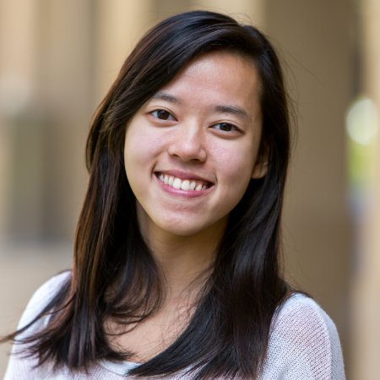
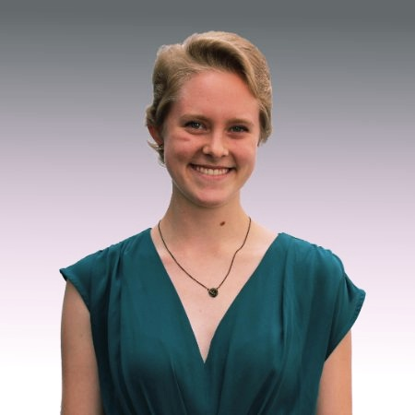
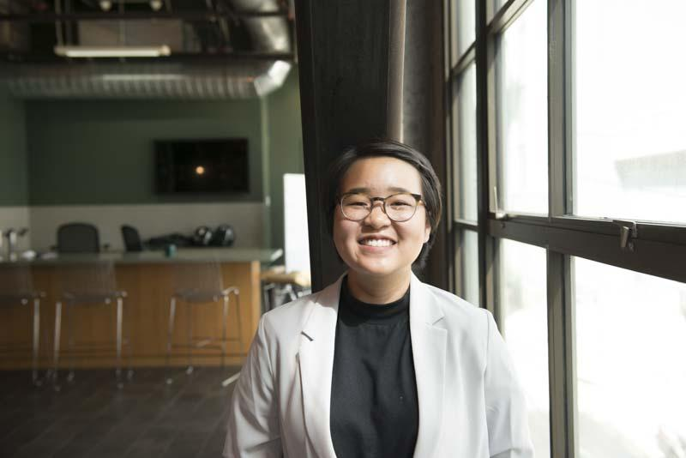
TEAM MEMBERS
Po Tsui
Bonnie Nortz
Jenny Kim
Grace Hong

Slide 3
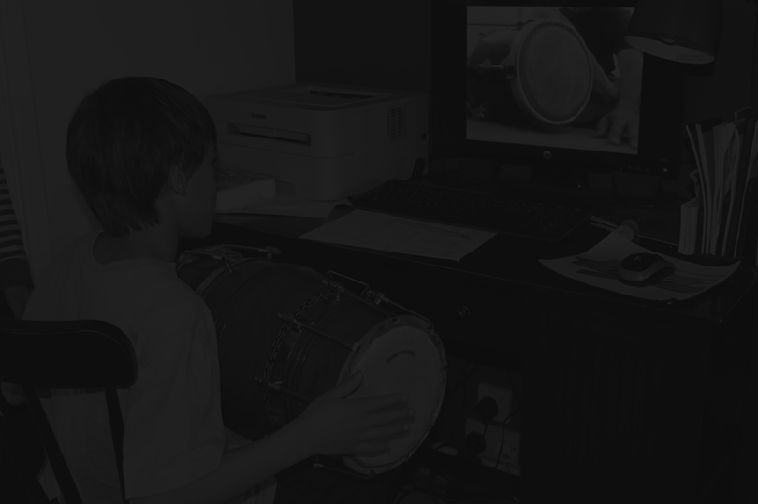
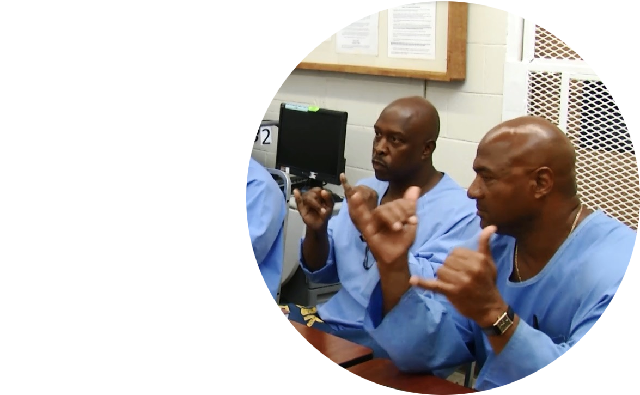
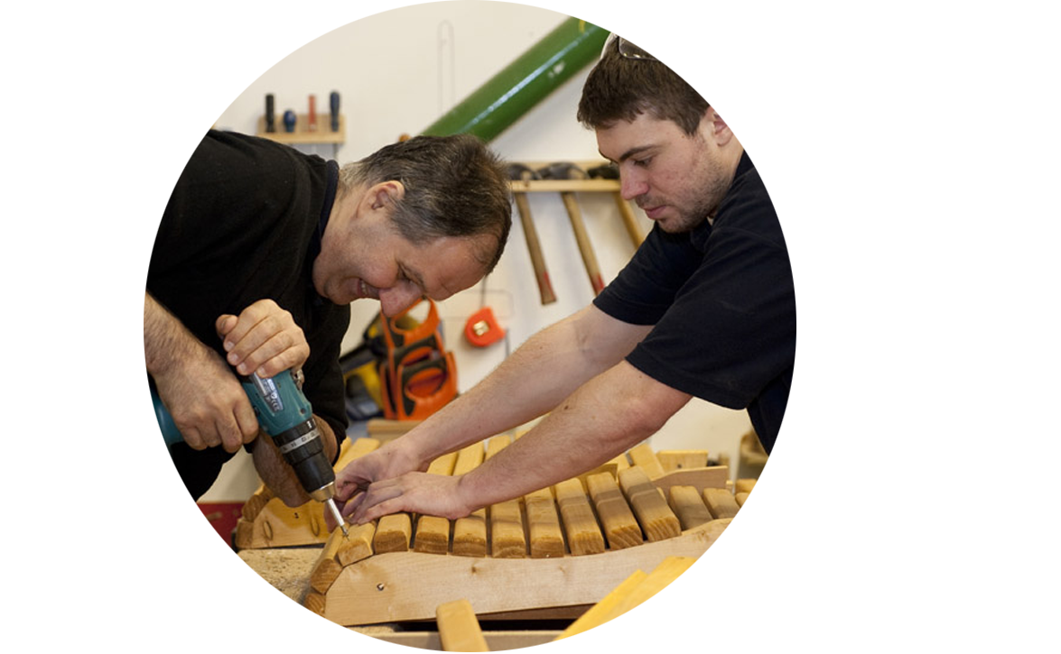
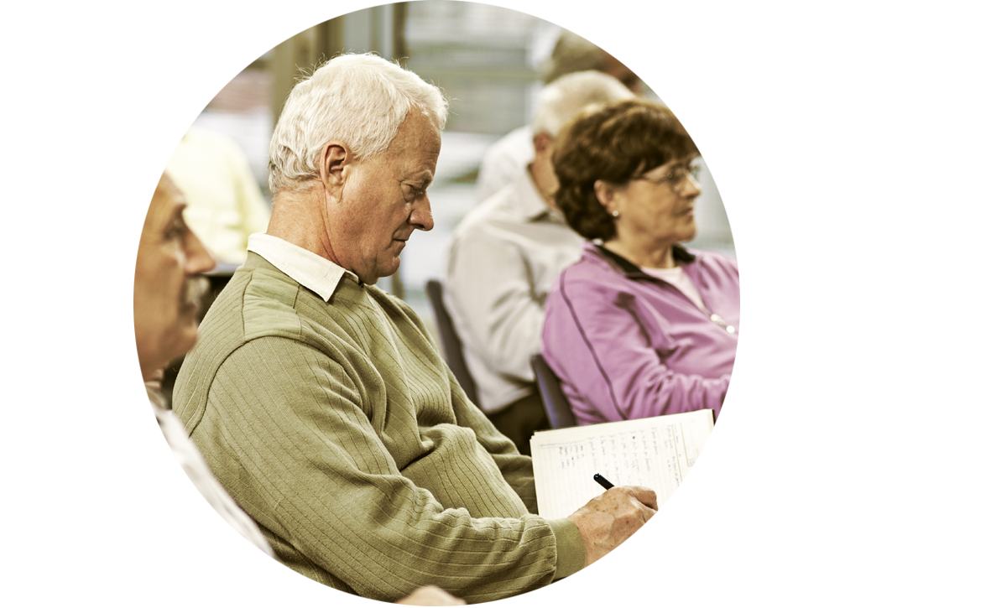

EDUCATING EMPATHY

Slide 4
INITIAL POV
We met … Sandy, mother, soccer coach, and Intuit employee
We were amazed to realize … her love for her daughter inspired her to become a soccer coach, despite never having played soccer before.
It would be game changing to … leverage the emotional and interpersonal connections we have with others to inspire us to venture outside our comfort zone and learn new things.

Slide 5
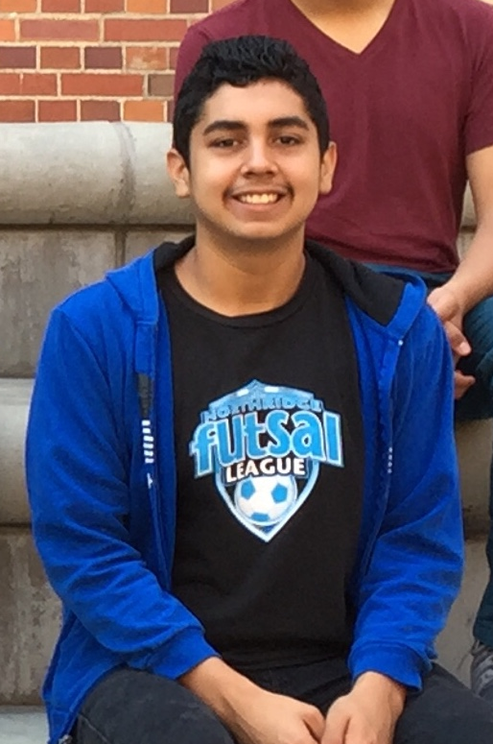
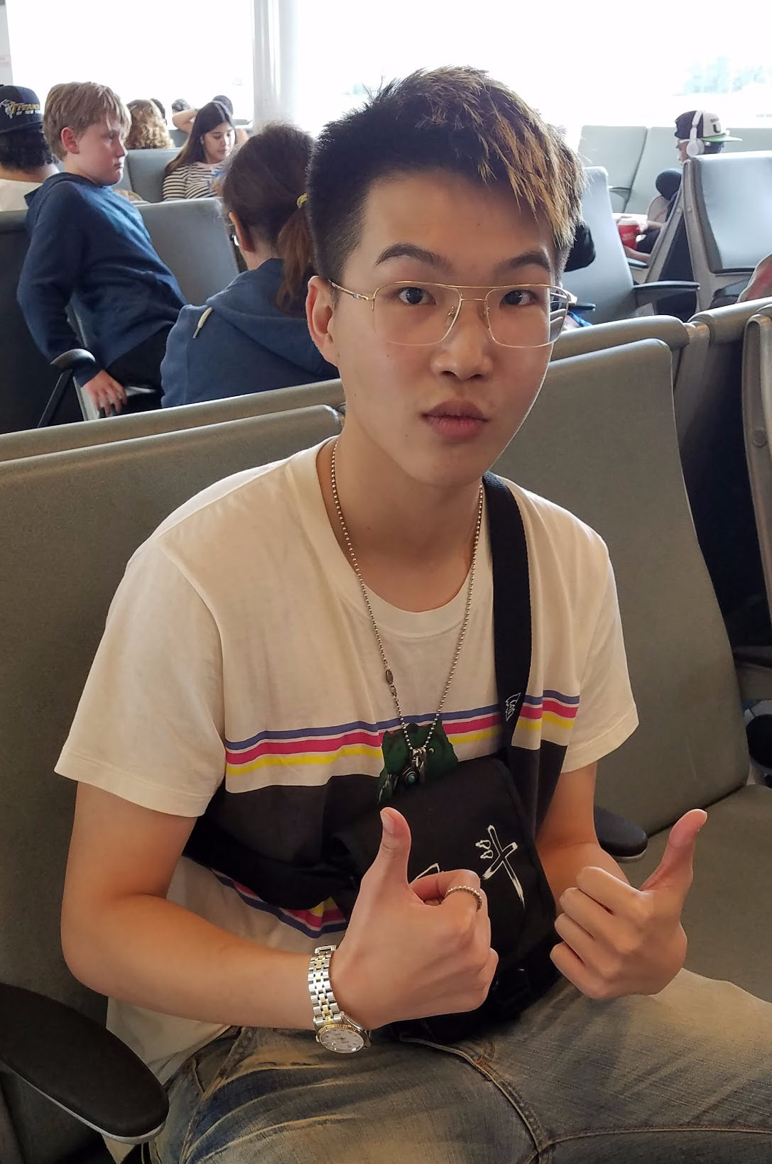
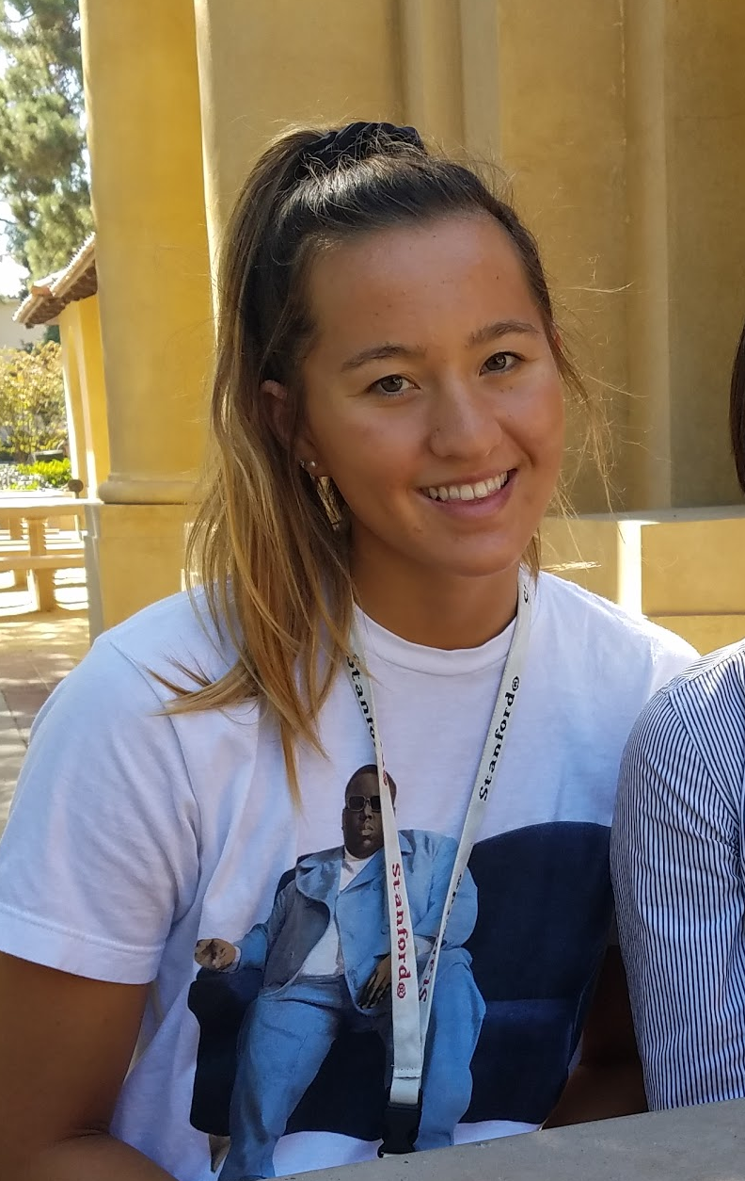
Additional Needfinding
CHRISTIAN
HAN
KATIE

Slide 6
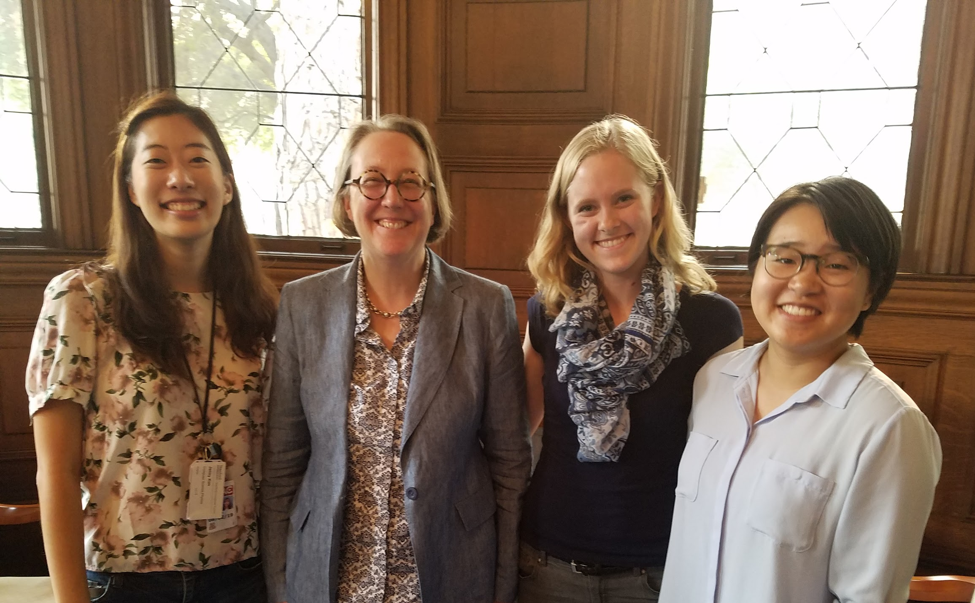

Slide 7
WE MET | CHRISTIAN
Junior at LACES, a high school in inner-city LA
We were amazed to find he used to use the N word in middle school but was eventually corrected by an African American friend, and now he still feels regret for being culturally insensitive.
It would be game-changing to have a safe space for teens to ask questions and be educated about taboo topics that may otherwise not be addressed on a day-to-day basis.

Slide 8
WE MET | HAN
International freshman studying at Stony Brook University
We were amazed to learn he smokes to hang out with his international friends as part of mainland Chinese culture, but is negatively judged for this by some of his American counterparts.
It would be game-changing to communicate the cultural differences that explain his behavior to people who don’t understand.

Slide 9
WE MET | KATIE
A Catholic Freshman from SoCal on the Stanford Swimming Team
We were amazed to learn that she didn’t have a clear idea of what her friends believed or their worldviews despite feeling very close to them.
It would be game-changing to make this a natural thing to know about your friends.

Slide 10

HOW MIGHT WE . . .
Create spaces for open conversations
where people can ask questions
without worrying about offending others,
and without actually offending them?

Slide 11
HOW MIGHT WE . . .
Encourage the formation of
friendships across different identities
in a school setting?

Slide 12
HOW MIGHT WE . . .
Allow friends who merely hang out together
to enter more substantial and meaningful conversation topics?

Slide 13
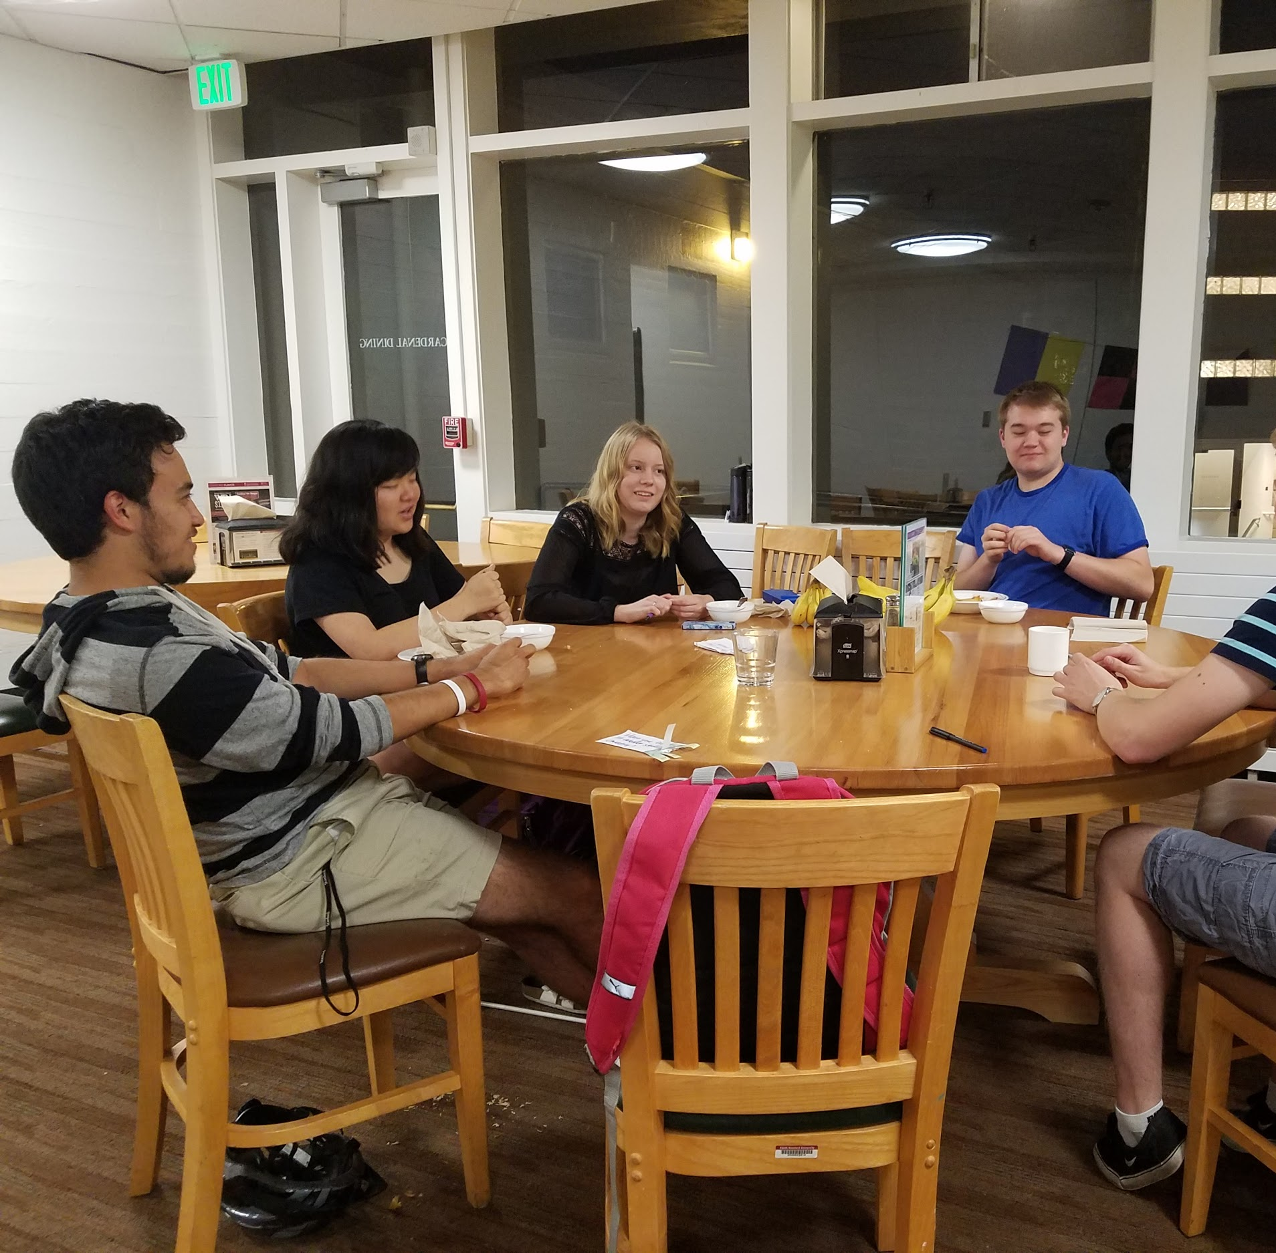
PROTOTYPE | HIDDEN QUESTIONS
Would recognizing that other people have the same questions and desire to talk about these topics encourage deeper discussion on serious issues?
The game generated a lot of interest, from players and from passerbys
Questions of varying seriousness piqued the participants’ interest
Participants already felt like they knew each other, game felt superfluous
Group was not interested in asking the deeper questions
Notes:
How might we Allow friends who merely hang out together to enter more substantial and meaningful conversation topics?

Slide 14
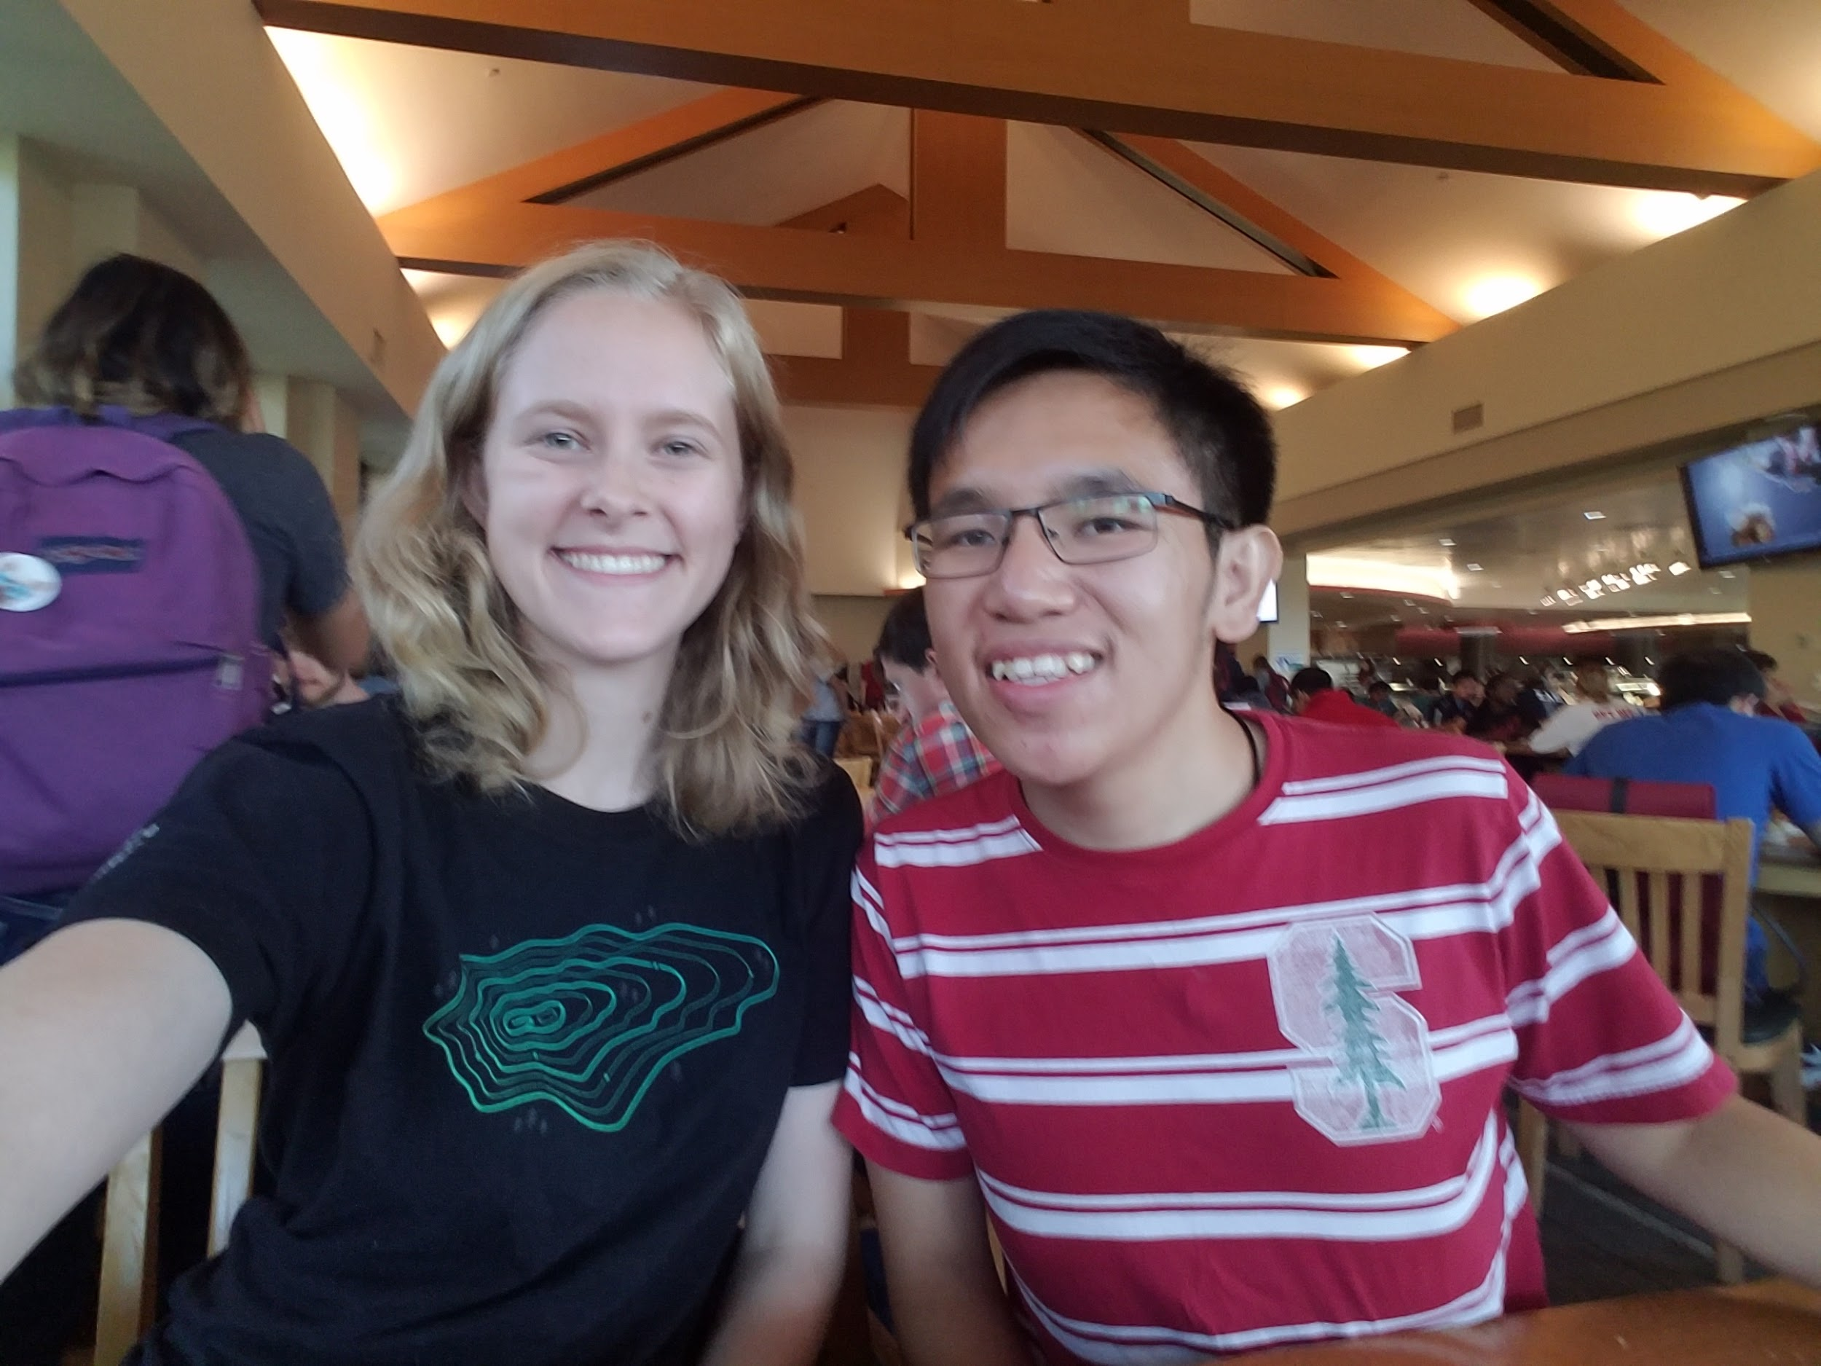
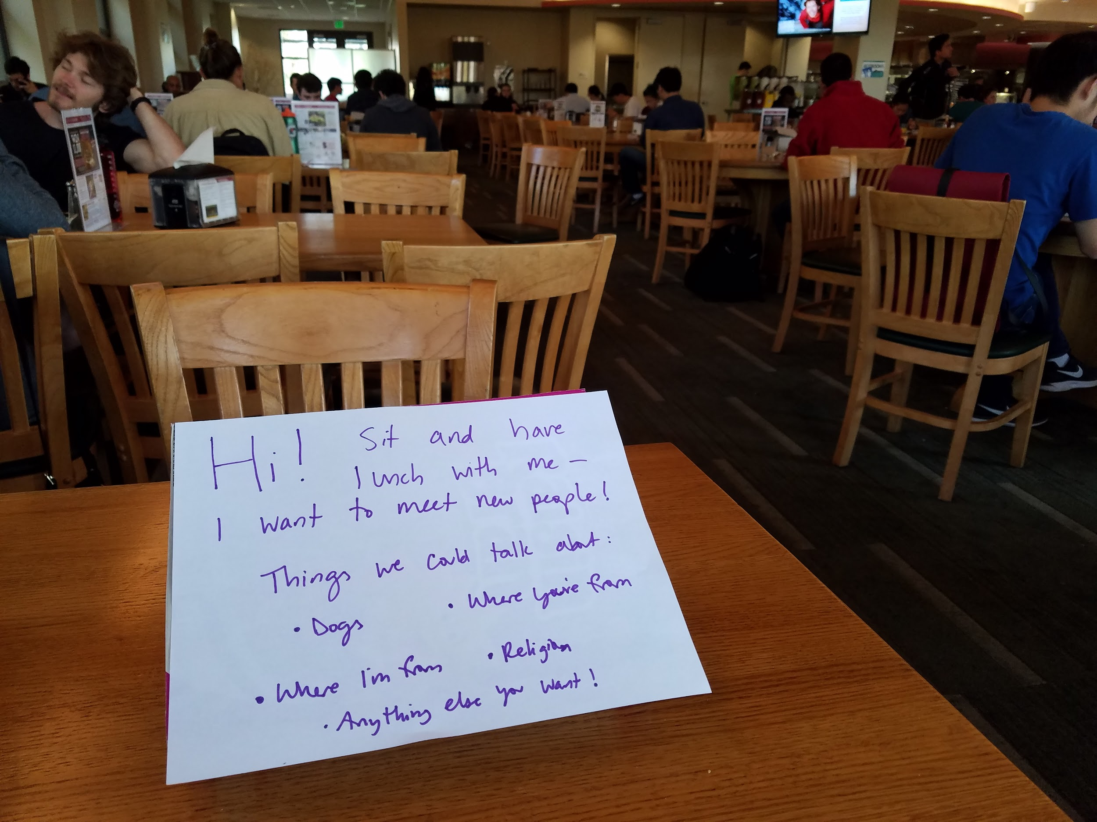
PROTOTYPE | MEAL BUDDY
Would you sit with a stranger different from you over a meal, if you knew they were open to sitting with you?
The sign/invitation attracted a participant within five minutes of it being posted
Bonnie met someone she never would have otherwise gotten to know
Though curiosity was piqued, other people seemed to consider the sign eccentric
Experience of sitting with sign was a bit embarrassing
Notes:
Encourage the formation of friendships across different identities in a school setting?

Slide 15
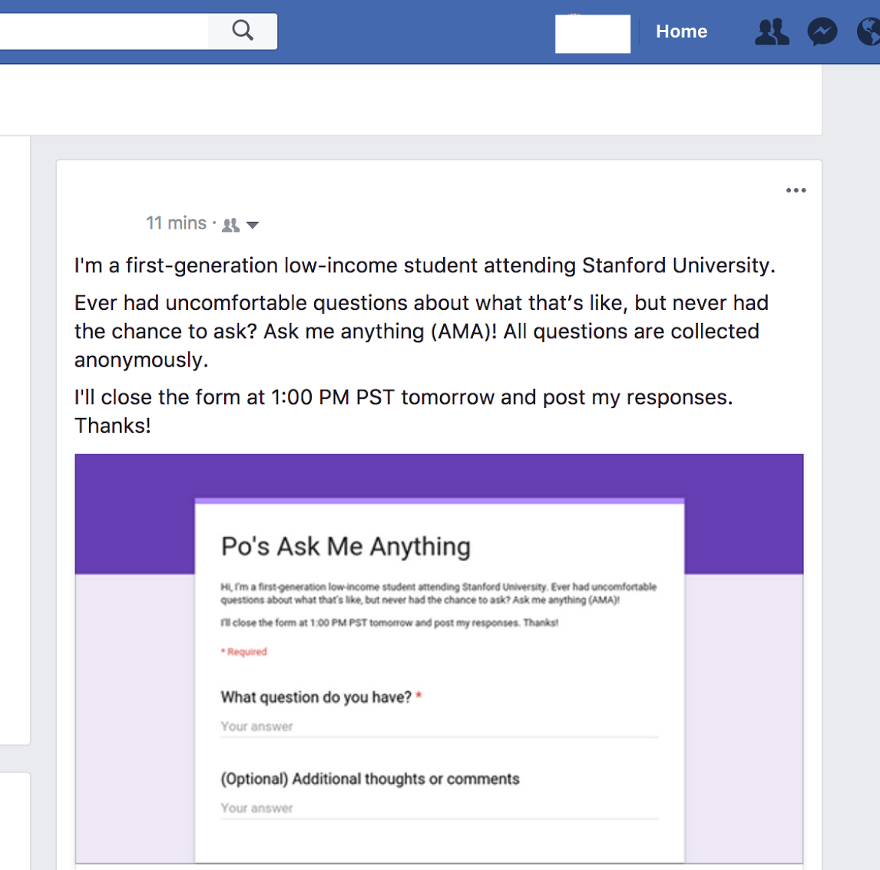
PROTOTYPE | FACEBOOK AMA
Do anonymity and openness foster deeper conversations between friends?
Gained deeper understanding of self and friendships
Were asked very deep questions
Questions were not consistently about taboo topics or identity
Uncomfortable power dynamics around anonymity
Notes:
Addresses:
How might we create spaces for open conversations where people can ask questions without worrying about offending others, and without actually offending them?
Core areas of our problem space: connecting people with different beliefs and perspectives, creating lines of honest and open communication between communities, generating empathy between individuals from different walks of life
Really amazing and deep questions from Bonnie’s side: “What was it like to tell your parents?”, “What made you change your mind about god?” “Are you Anti-catholic now? Do you believe in a higher power?”

Slide 16

QUESTIONS

